Slide 1


Alcohol
Chapter 22

Slide 2







12 fl oz of regular beer | = | 8-9 fl oz of malt liquor (shown in a 12-oz glass) | = | 5 fl oz of table wine | = | 3-4 oz of fortified wine (such as sherry or port; 3.5 oz shown) | = | 2-3 oz of cordial, liqueur, or aperitif (2.5 oz shown) | = | 1.5 oz of brandy (a single jigger or shot) | = | 1.5 fl oz shot of 80-proof spirits ("hard liquor")
about 5% alcohol |  | about 7% alcohol |  | about 12% alcohol |  | about 17% alcohol |  | about 24% alcohol |  | about 40% alcohol |  | about 40% alcohol
Metabolism factors: 1) body size 2) gender 3) food 4) amount & rate 5) tolerance

Slide 3
Foldable
2 pieces of paper folded top to bottom
Label each section
  Short-term effects
  DUI
  Alcohol poisoning
  Long-term effects (include FAS)
  Alcoholism
  Treatment

Slide 4
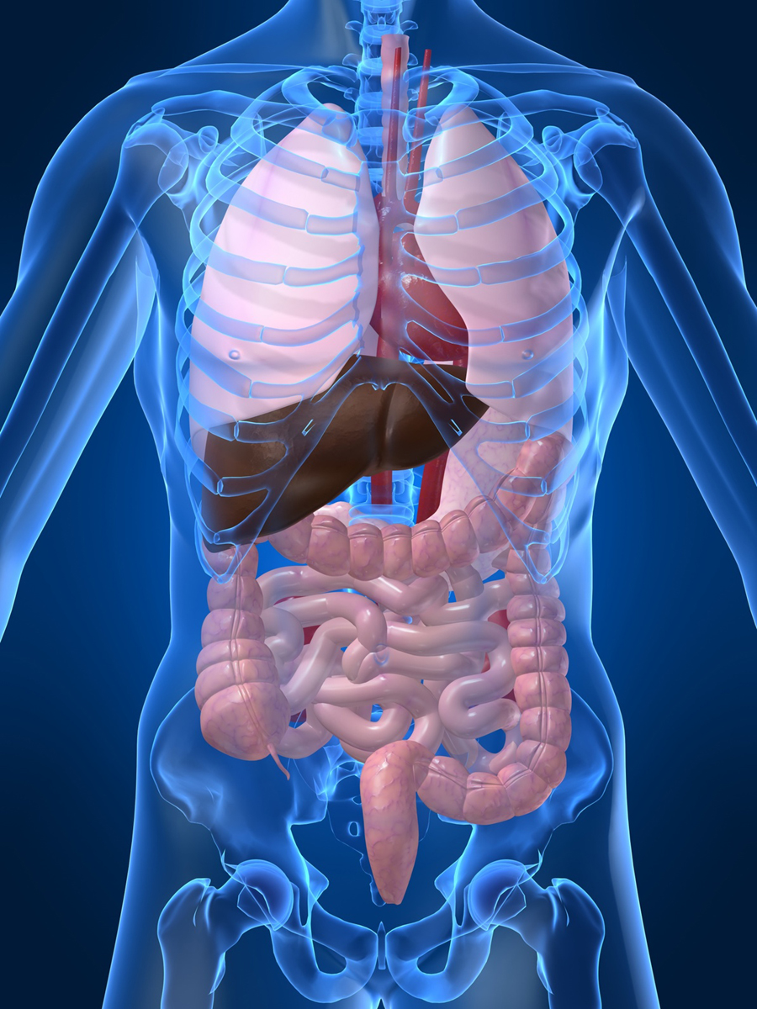
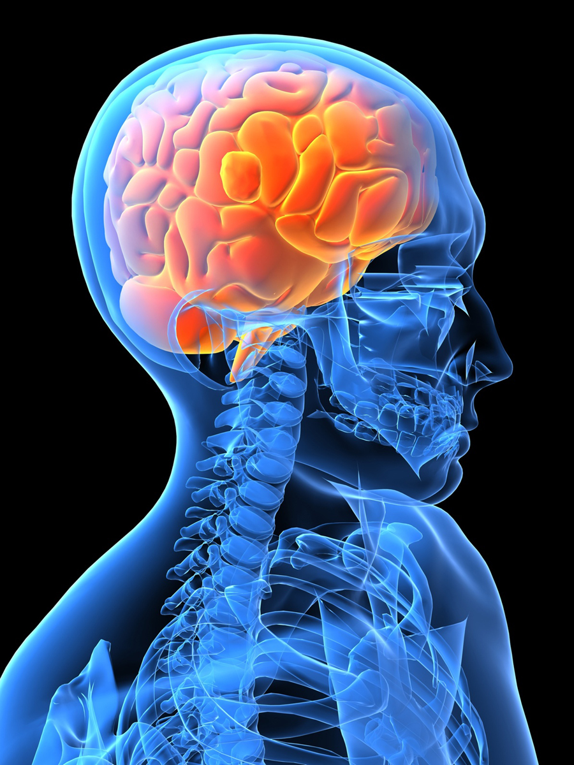
Short-term Effects
CNS- brain function, memory retentions, & judgement
Cardio- depress heart & expand blood vessles
Digestive- increase stomach acid, overload liver & kidneys (dehydration)
Respiratory- increase lung function b/c CO2 from liver & breathing
alcohol & the brain

Slide 5
DUI
BAC- % of alcohol in blood
Effects: slow reflexes, distance & speed perception, lack of concentration, increased risk-taking behavior
Consequences: lose license, dropped by insurance, fines, court costs, etc
drunk driving (Matt)

Slide 6
Binge drinking->Alcohol poisoning
5+ drinks in one setting
Alcohol poisoning- slowed respiration, vomit, speech, body temp
Effects- coma, seizure, irregular heartbeat, hypothermia, dehydration, death
      *GO TO THE HOSPITAL!

Slide 7
Long term Effects
Brain: addiction, loss of function, brain damage (CO2)
Cardio: enlarged heart, high BP
Liver: fatty liver, hepatitis C, cirrhosis
Dr. Drew - liver
Digestive: ulcers & acid reflux
Pancreas: scar tissue blocks the small intestine

Slide 8
Alcoholism
Stage One: Abuse
Stage Two: Dependence
Stage Three: Addiction
science of addiction

Slide 9
Treatment (Recovery)
Admission
Detox
Counseling
Sobriety

Slide 10
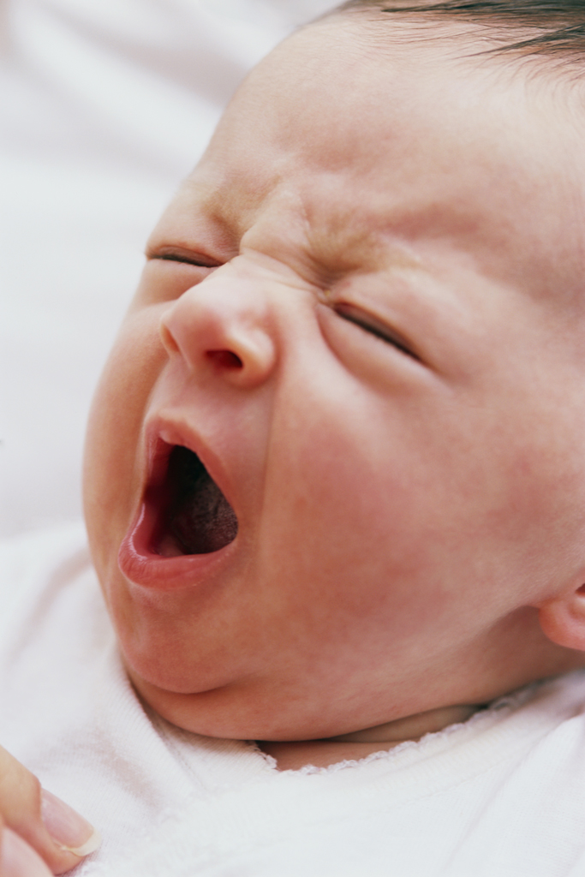
Pregnancy
Fetus can NOT process alcohol
1st trimester = riskiest
FAS
  smaller head
  Deformities
  Heart, liver, kidney damage
  Vision, hearing problems
  Slow growth & coordination
  LD, attention, memory, & problem-solving problems

