Slide 1
Dietary Guidelines for Americans
DGA

Slide 2
“A”-Aim for Fitness
Healthy weight (BMI)
Daily physical activity

Slide 3
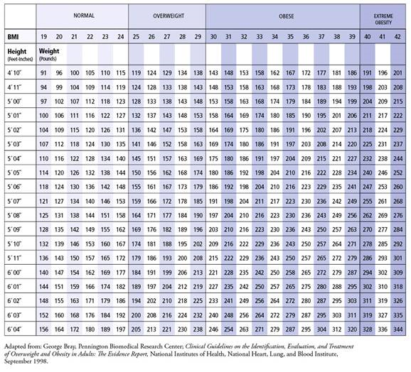

Slide 4
“B”-Build a Healthy Base
Food guide pyramid
http://www.youtube.com/watch?v=DS8MegEiKLk
Variety of grains
Variety of fruits & vegetables
Food safety (preparation) http://www.youtube.com/watch?feature=player_detailpage&v=UXSxJF43XGA

Slide 5
“C”-Choose sensibly
Low fat/cholesterol
Food & drink w/low sugar
Less salt

Slide 6
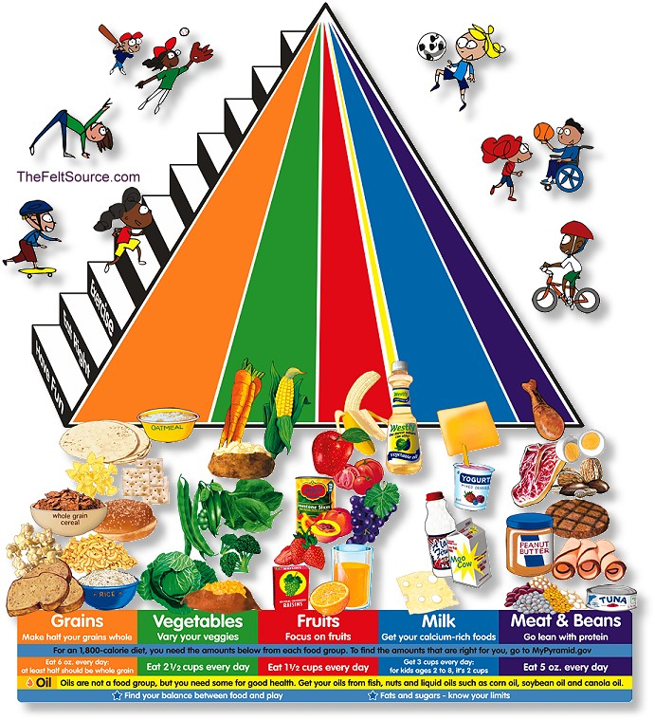

Slide 8
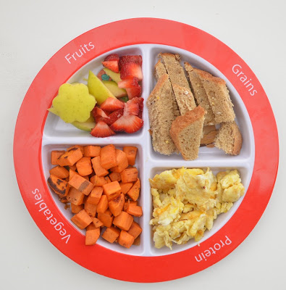

Slide 9
2000 calories

Slide 10
What’s in your food?

Slide 11
Nutrition Label Game Show
https://www.youtube.com/watch?v=DjFVOZ_ALuM

Slide 12
Label Review

